Slide 1
bone marrow
Mario Huerta
Cindy Forni
Anna Page

Slide 2
Learning Objectives:
Know what bone marrow is
Know what a bone marrow transplant is
Who are good candidates for a bone marrow transplant
Advantages vs. Disadvantages of a bone marrow transplant
Who can be a donor and where can one register.
Learn the meaning of graft-versus-host disease

Slide 3
History
The first successful transplant was performed by Dr. Thomas in Cooperstown, N.Y., in the late 1950s. The transplant involved identical twins, one of whom had leukemia. Because identical twins share the same genetic make-up, transplants between twins avoid the problems associated with non-twin transplants, such as graft-vs.-host disease.
It wasn't until 1968, in Minnesota, that the first successful non-twin (allogeneic) transplant was performed. In this case, the donor was a sibling of the patient. Because siblings receive DNA from the same parents, a sibling is the most likely person to be a good match.
The first successful unrelated donor transplant took place in 1973 in New York when a young boy with a genetic immunodeficiency disorder received multiple marrow transplants from a donor identified as a match through a blood bank in Denmark. The first successful unrelated donor transplant for a patient with leukemia took place in 1979 at the Hutchinson Center.
Notes:
http://www.fhcrc.org/en/treatment/long-term-follow-up/FAQs/transplantation.html

Slide 4
What is Bone Marrow?
Bone marrow is the soft, spongy tissue found inside bones. It is the medium for development and storage of most of the body's blood cells.
The blood cells that produce other blood cells are called stem cells. The most primitive of the stem cells is called the pluripotent stem cell, which is different than other blood cells with regard to the following properties:
Renewal. It is able to reproduce another cell identical to itself.
Differentiation. It is able to generate one or more subsets of more mature cells.
It is the stem cells that are needed in bone marrow

Slide 5
Why is a bone marrow transplant needed?
The goal of a bone marrow transplant is to cure many diseases and types of cancer. When the doses of chemotherapy or radiation needed to cure a cancer are so high that a person's bone marrow stem cells will be permanently damaged or destroyed by the treatment, a bone marrow transplant may be needed. Bone marrow transplants may also be needed if the bone marrow has been destroyed by a disease.

Slide 6
A bone marrow transplant can be used to:
Replace diseased, nonfunctioning bone marrow with healthy functioning bone marrow (for conditions such as leukemia, aplastic anemia, and sickle cell anemia).
Regenerate a new immune system that will fight existing or residual leukemia or other cancers not killed by the chemotherapy or radiation used in the transplant.
Replace the bone marrow and restore its normal function after high doses of chemotherapy and/or radiation are given to treat a malignancy. This process is often called rescue (for diseases such as lymphoma and neuroblastoma).
Replace bone marrow with genetically healthy functioning bone marrow to prevent further damage from a genetic disease process (such as Hurler's syndrome and adrenoleukodystrophy).
Notes:
http://www.hopkinsmedicine.org/healthlibrary/conditions/hematology_and_blood_disorders/bone_marrow_transplantation_85,P00086/

Slide 7
Many different medical tests may be done, and questions will be asked to try to find out how well you can handle the transplant process. These might include:
- HLA tissue typing, including high-resolution typing
- A complete health history and physical exam
- Evaluation of your psychological and emotional strengths
- Identifying who will be your primary caregiver throughout the transplant process
- Bone marrow biopsy
- CT (computed tomography) scan or MRI (magnetic resonance imaging)
- Heart tests, such as an EKG (electrocardiogram) or echocardiogram
- Lung studies, such as a chest x-ray and PFTs (pulmonary function tests)
- Consultations with other members of the transplant team, such as a dentist, dietitian, or social worker
- Blood tests, such as a complete blood count, blood chemistries, and screening for viruses like hepatitis B, CMV, and HIV
Notes:
http://www.cancer.org/treatment/treatmentsandsideeffects/treatmenttypes/bonemarrowandperipheralbloodstemcelltransplant/stem-cell-transplant-transplant-process

Slide 8
How is a bone marrow donor chosen?
The process of selecting an appropriate donor for a bone marrow transplant is actually a very time consuming and tedious task. It is very important that you and your donor match up on a genetic level as best as possible to ensure the best results, so you can assume this is a very important task. This is done using special tests known as HLA typing.
Family members (mom, dad, and siblings) are the first to be screened to see if they are a match because they are most likely to be potential donors. If your family does not happen to be a perfect match, the next place they look is the National Marrow Donor Program. This is a large system where they have records of potential donors who are generous and willing to donate.

Slide 9
The recent advances in bone marrow transplant
Allogeneic hematopoietic cell transplantation (HCT) is currently the only treatment and curative potential for sickle cell disease and thalassemia.
HCT was 1st used to treat SCD and thalassemia more than 2 decades ago, it was once experimental but now its targeted for treatment.
Recent multicenter clinical studies show an event-free survival of 85% after human leukocyte antigen (HLA)- identical sibling transplantation for SCD Thalassemia 81-87%

Slide 10
Clinical correlation &significance
The clinical correlation in bone marrow transplant is that in order to perform such an invasive procedure there needs to be a comprehension of the cells mechanisms and interactions. By this we mean the importance of t-helper cells, B-lymphocytes, and cytotoxic cells regarding bone marrow. All three of these have specific roles when dealing with this treatment.

Slide 11
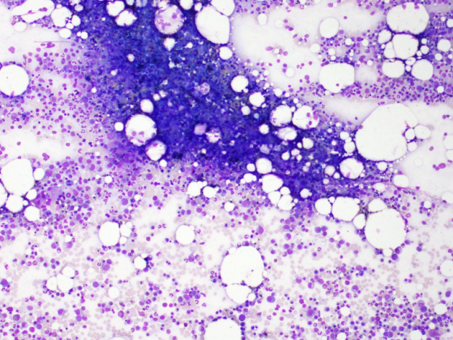
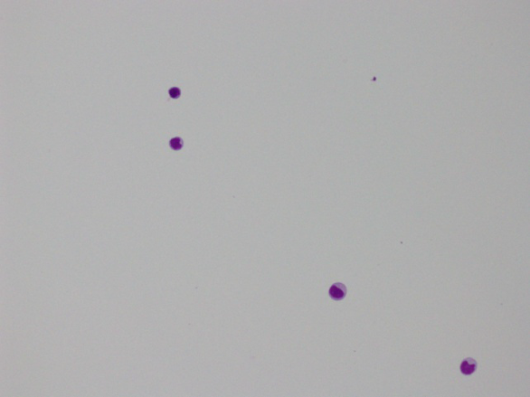
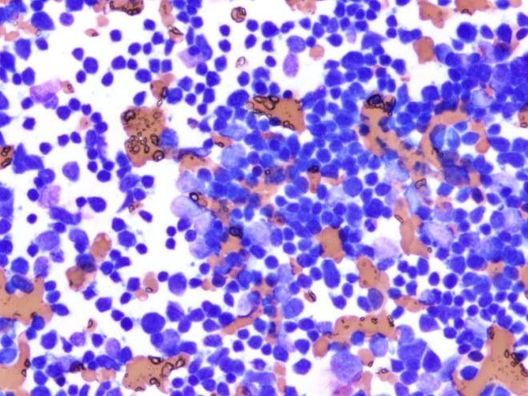
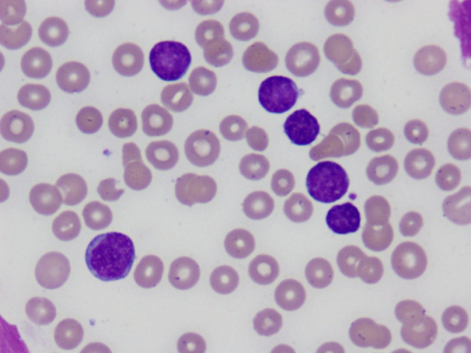
Before treatment after treatment

Slide 12
Questions:
1. What is bone marrow?
Hard, dense tissue found on the outside of the bone
Soft, spongy tissue found inside bones
Fluid consistency inside the bones
Soft, jelly tissue found inside bones

Slide 13
2. How is a donor chosen
Anyone can be a donor
Family members are the first to be matched and screened
The national cancer association
National Marrow donor program
All of the above
B and D

Slide 14
3.What is the only treatment with a curative potential for sickle cell disease & Thalassemia
Chemotherapy
Vaccination
Bone Marrow Transplant
Radiation Therapy

Slide 15
4. A bone marrow transplant is a method of treatment for what types of diseases?
Lupus
Cancers
Sickle cell disease & thalassemia
B, C

Slide 16
answers
1.B
2.F
3.C
4.D

Slide 17
Resources
http://www.fhcrc.org/en/treatment/long-term-follow-up/FAQs/transplantation.html
http://www.hopkinsmedicine.org/healthlibrary/conditions/hematology_and_blood_disorders/bone_marrow_transplantation_85,P00086/
http://www.cancer.org/treatment/treatmentsandsideeffects/treatmenttypes/bonemarrowandperipheralbloodstemcelltransplant/stem-cell-transplant-transplant-process
Children's Hospital And Research Center Oakland
Stem cell transplantation: A Clinical Textbook
Oncology Nursing Press, Inc. Leonard Mafrica, MBA, CAE. Barbera sigler, RN MNED. Lisa M. George, BA. Chad Chronick, Dany Sjoen

